Slide 1

How to Win the Donuts!
A Quiz Round

Slide 2

Instructions
Wikihow (www.wikihow.com) provides step-by-step instructions on how to do a great number of things.
What follows will be 10 pictures each from a different wikihow tutorial, with the text instructions cropped out.
All you have to do is pick the correct article title from the options provided that the image came from.

Slide 3
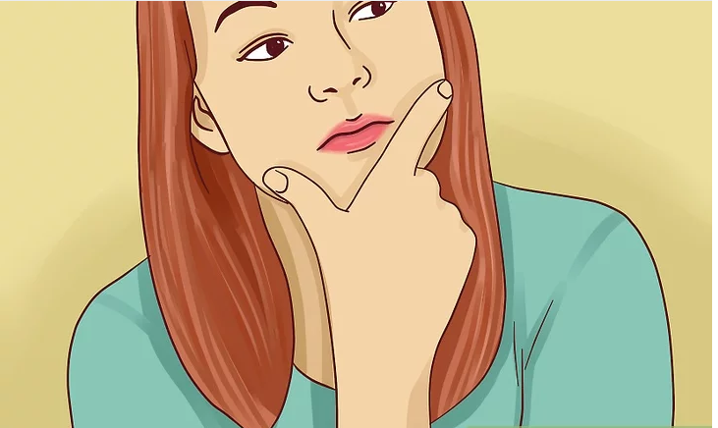
Q1
g
How to Appreciate Death Metal
How to Have an Attractive Thinking Face
How to Stop Being Indecisive
How to Come to Terms with the Inevitable Heat Death of the Universe

Slide 4
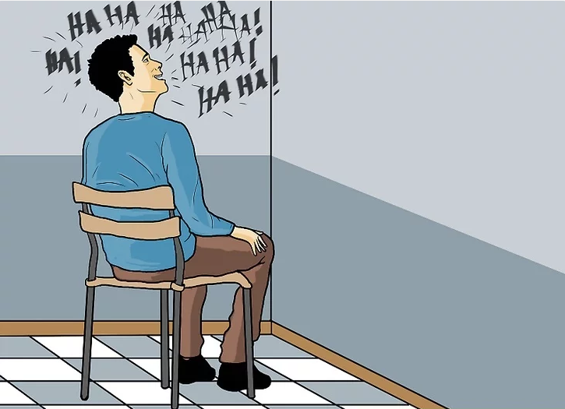
Q2
g
How to Speak Welsh
How to Train Yourself to Yodel
How to Act Like You Are Possessed
How to Learn to be Happy With Your Laugh

Slide 5
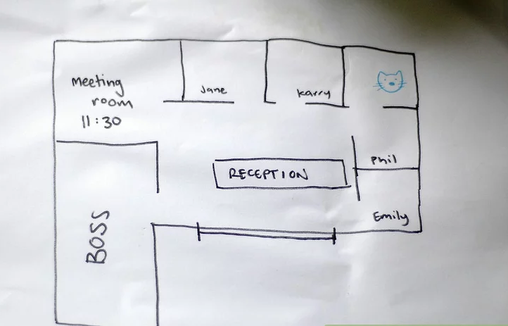
Q3
g
How to Commit the Perfect Robbery
How to Sneak Your Cat Into Work
How to Be an Architect
How to Social Distance at an Office

Slide 6
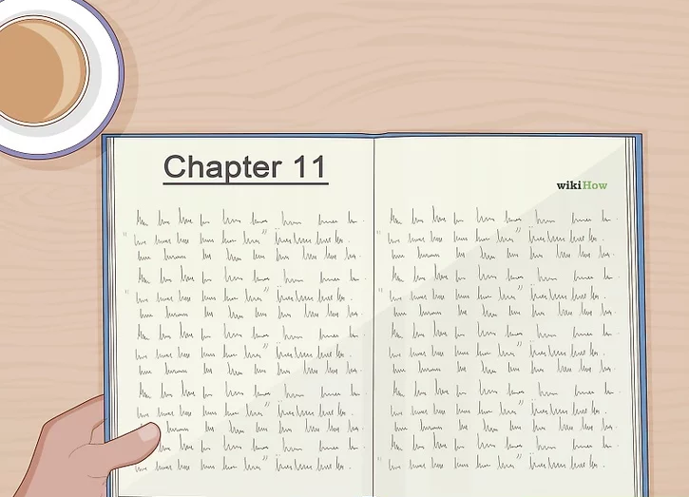
Q4
g
How to Learn Chinese
How to Read a Book
How to Not Be Awkward in a Coffee Shop
How to Invest in Bitcoin

Slide 7
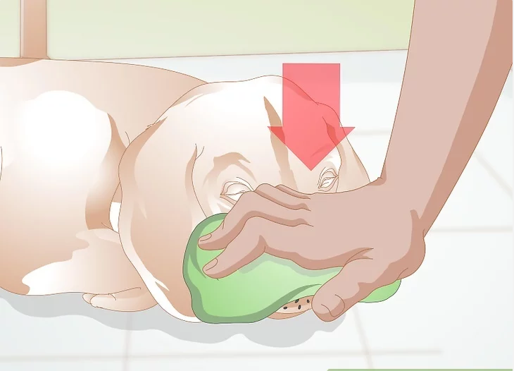
Q5
g
How to Raise a Pet
How to Make Your Dog Stop Barking
How to Treat Nosebleeds in Dogs
How to use Clip-Art

Slide 8
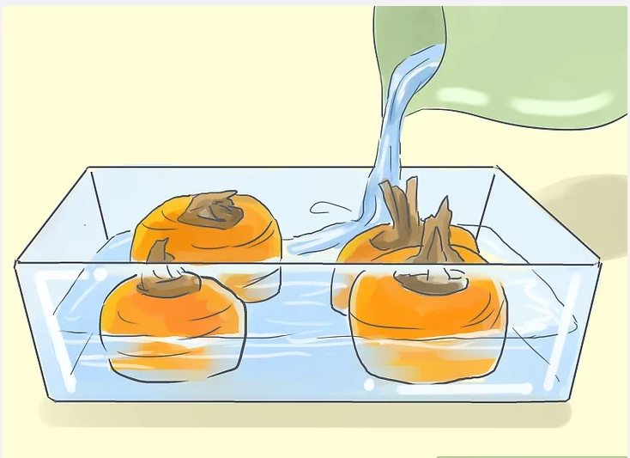
Q6
g
How to Regrow Vegetables
How to make Danish Soup
How to Make Natural Food Dye
How to Drown Carrots

Slide 9
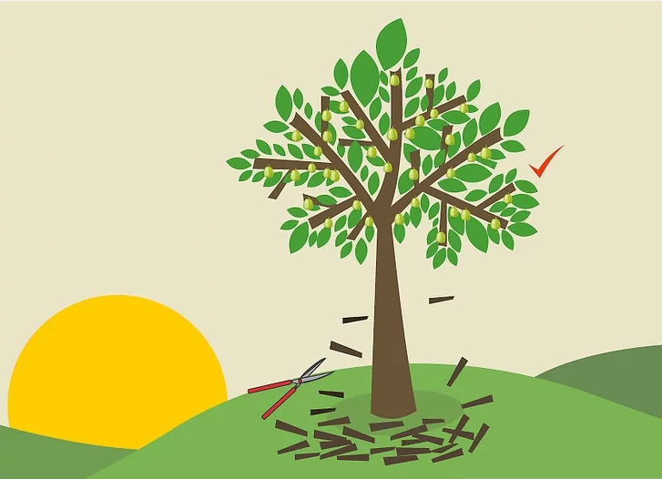
Q7
g
How to Prune Apple Trees
How to Make Cards from Magazine Cut-Outs
How to Prune Pear Trees
How to Prune Guava Trees

Slide 10
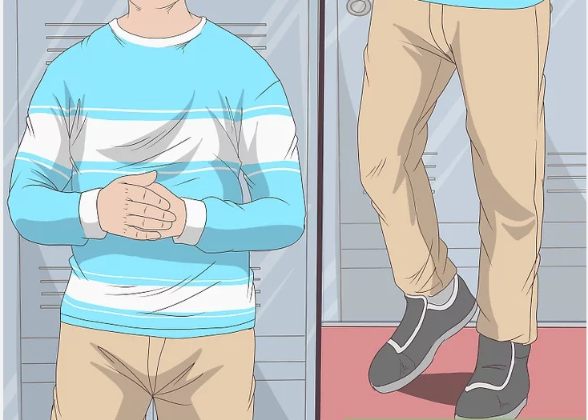
Q8
g
How to Stand Up to Bullies
How to Survive at High School
How to Prepare For a Flash Mob
Keep Mosquitos Away At Night

Slide 11
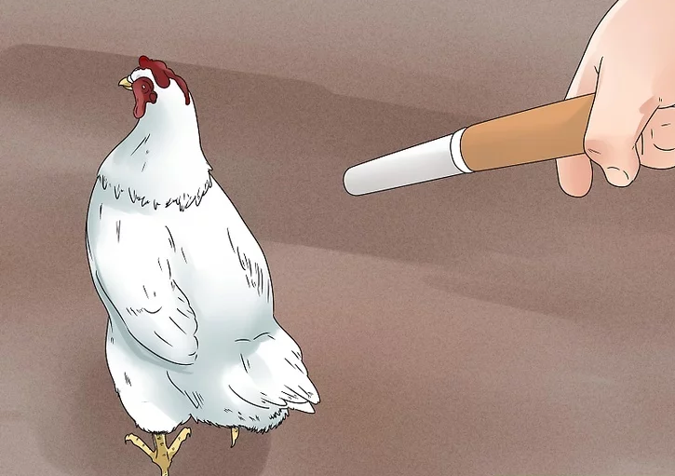
Q9
g
How to Repel Chickens
How to Offer a Cigarette to a Chicken
How to Practice Magic With Animals
How to Master Control Over Animals

Slide 12
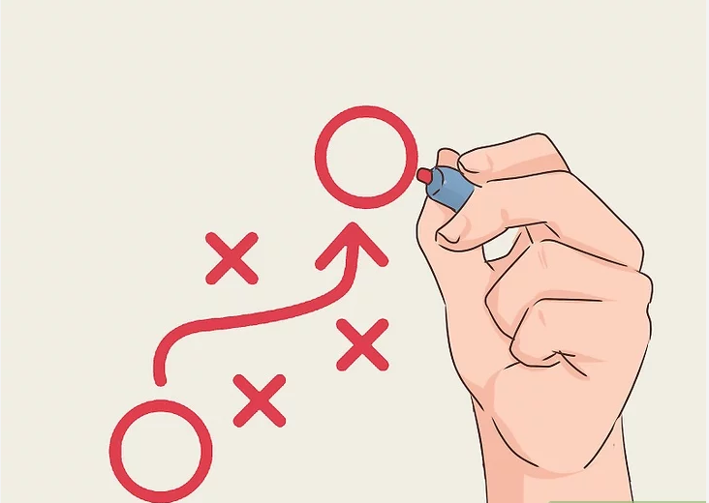
Q10
g
How to Play Football
How to Play Tic-Tac-Toe
How to Strategize
How to Draw With a Red Pen

Slide 13

Answers

Slide 14
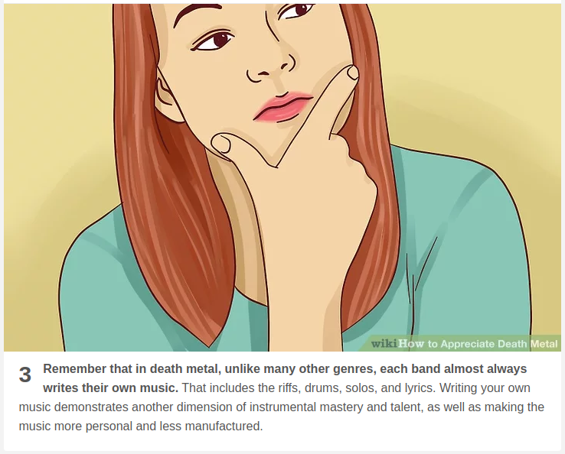
Question 1
How to... Appreciate Death Metal

Slide 15
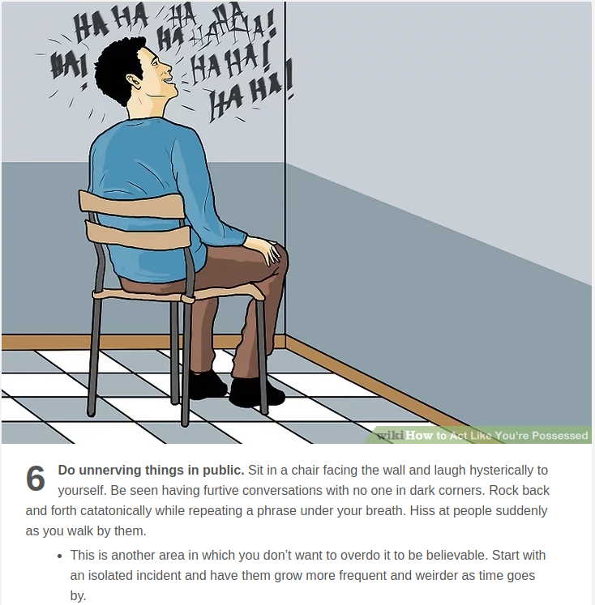
Question 2
How to... Act Like You’re Possessed

Slide 16
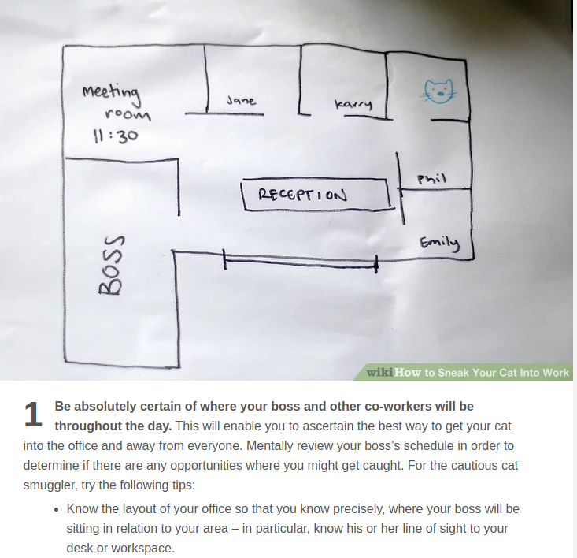
Question 3
How to… Sneak Your Cat Into Work

Slide 17
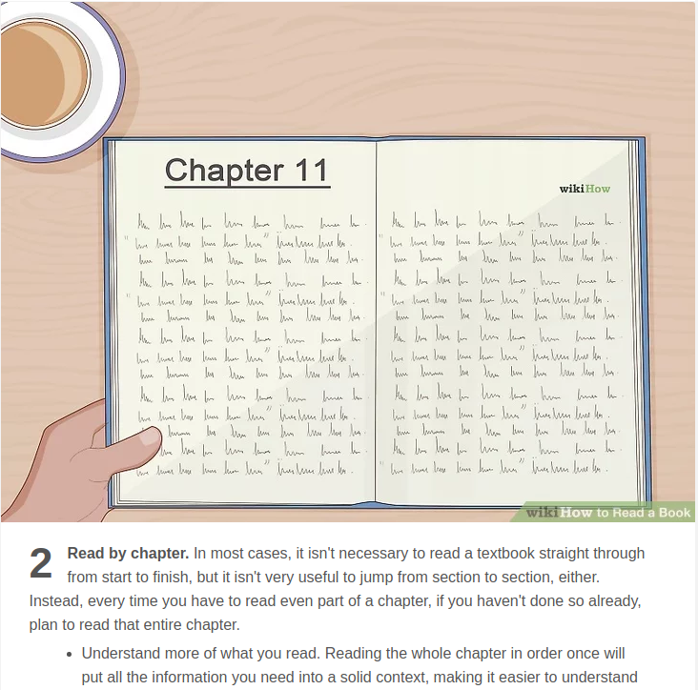
Question 4
How to... Read a Book

Slide 18
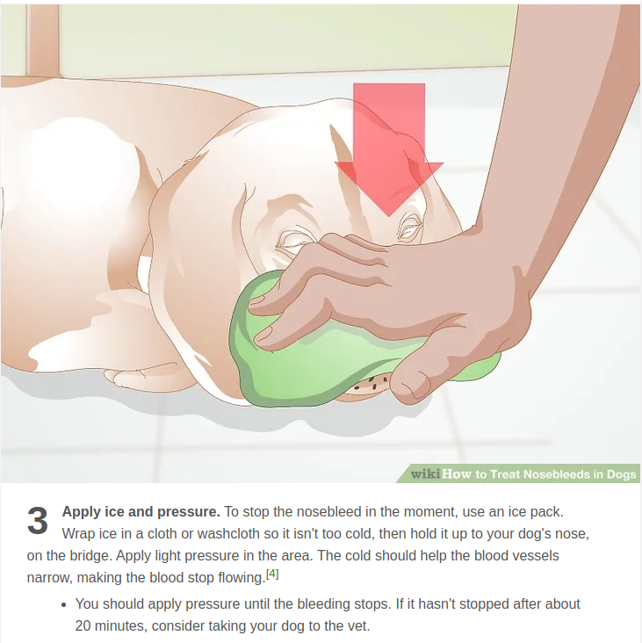
Question 5
How to… Treat Nosebleeds in Dogs

Slide 19
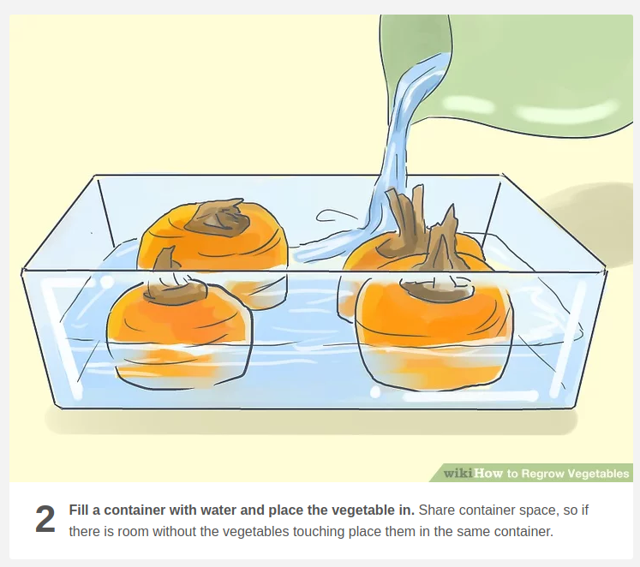
Question 6
How to... Regrow Vegetables

Slide 20
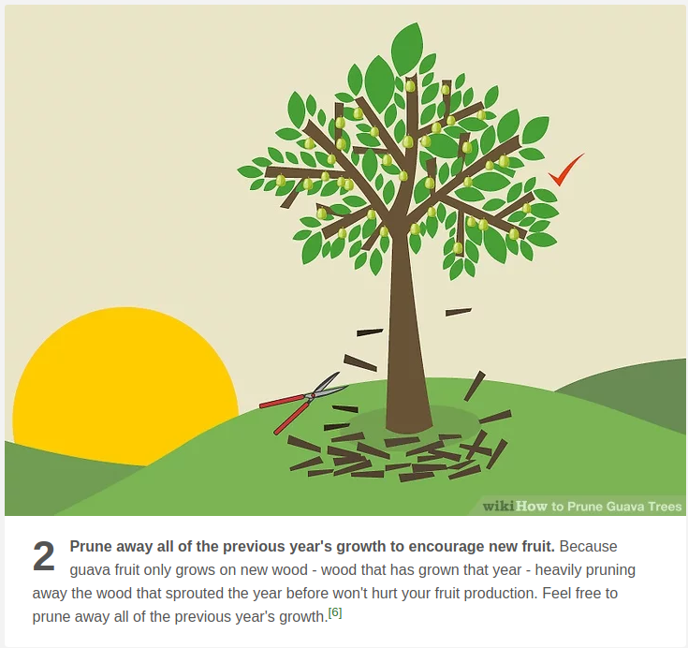
Question 7
How to… Prune Guava Trees

Slide 21
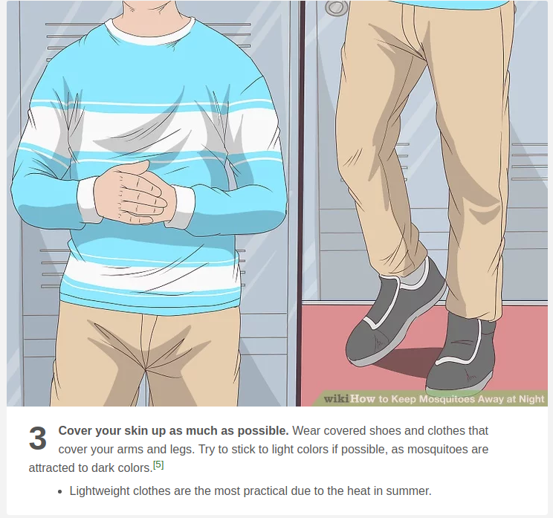
Question 8
How to... Keep Mosquitos Away At Night

Slide 22
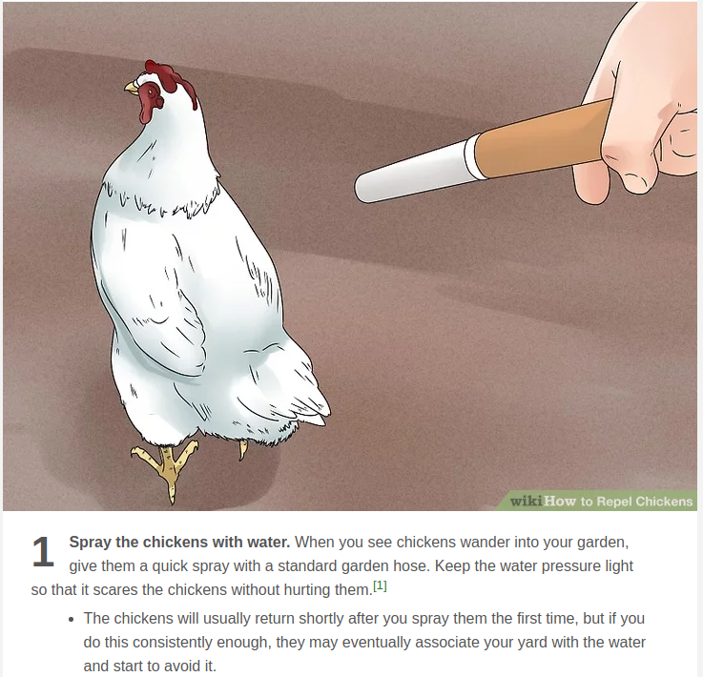
Question 9
How to… Repel Chickens

Slide 23
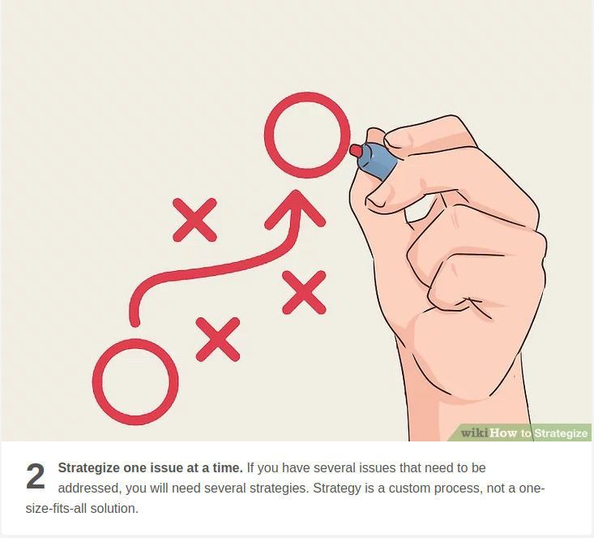
Question 10
How to... Strategize

Slide 24


